Slide 1

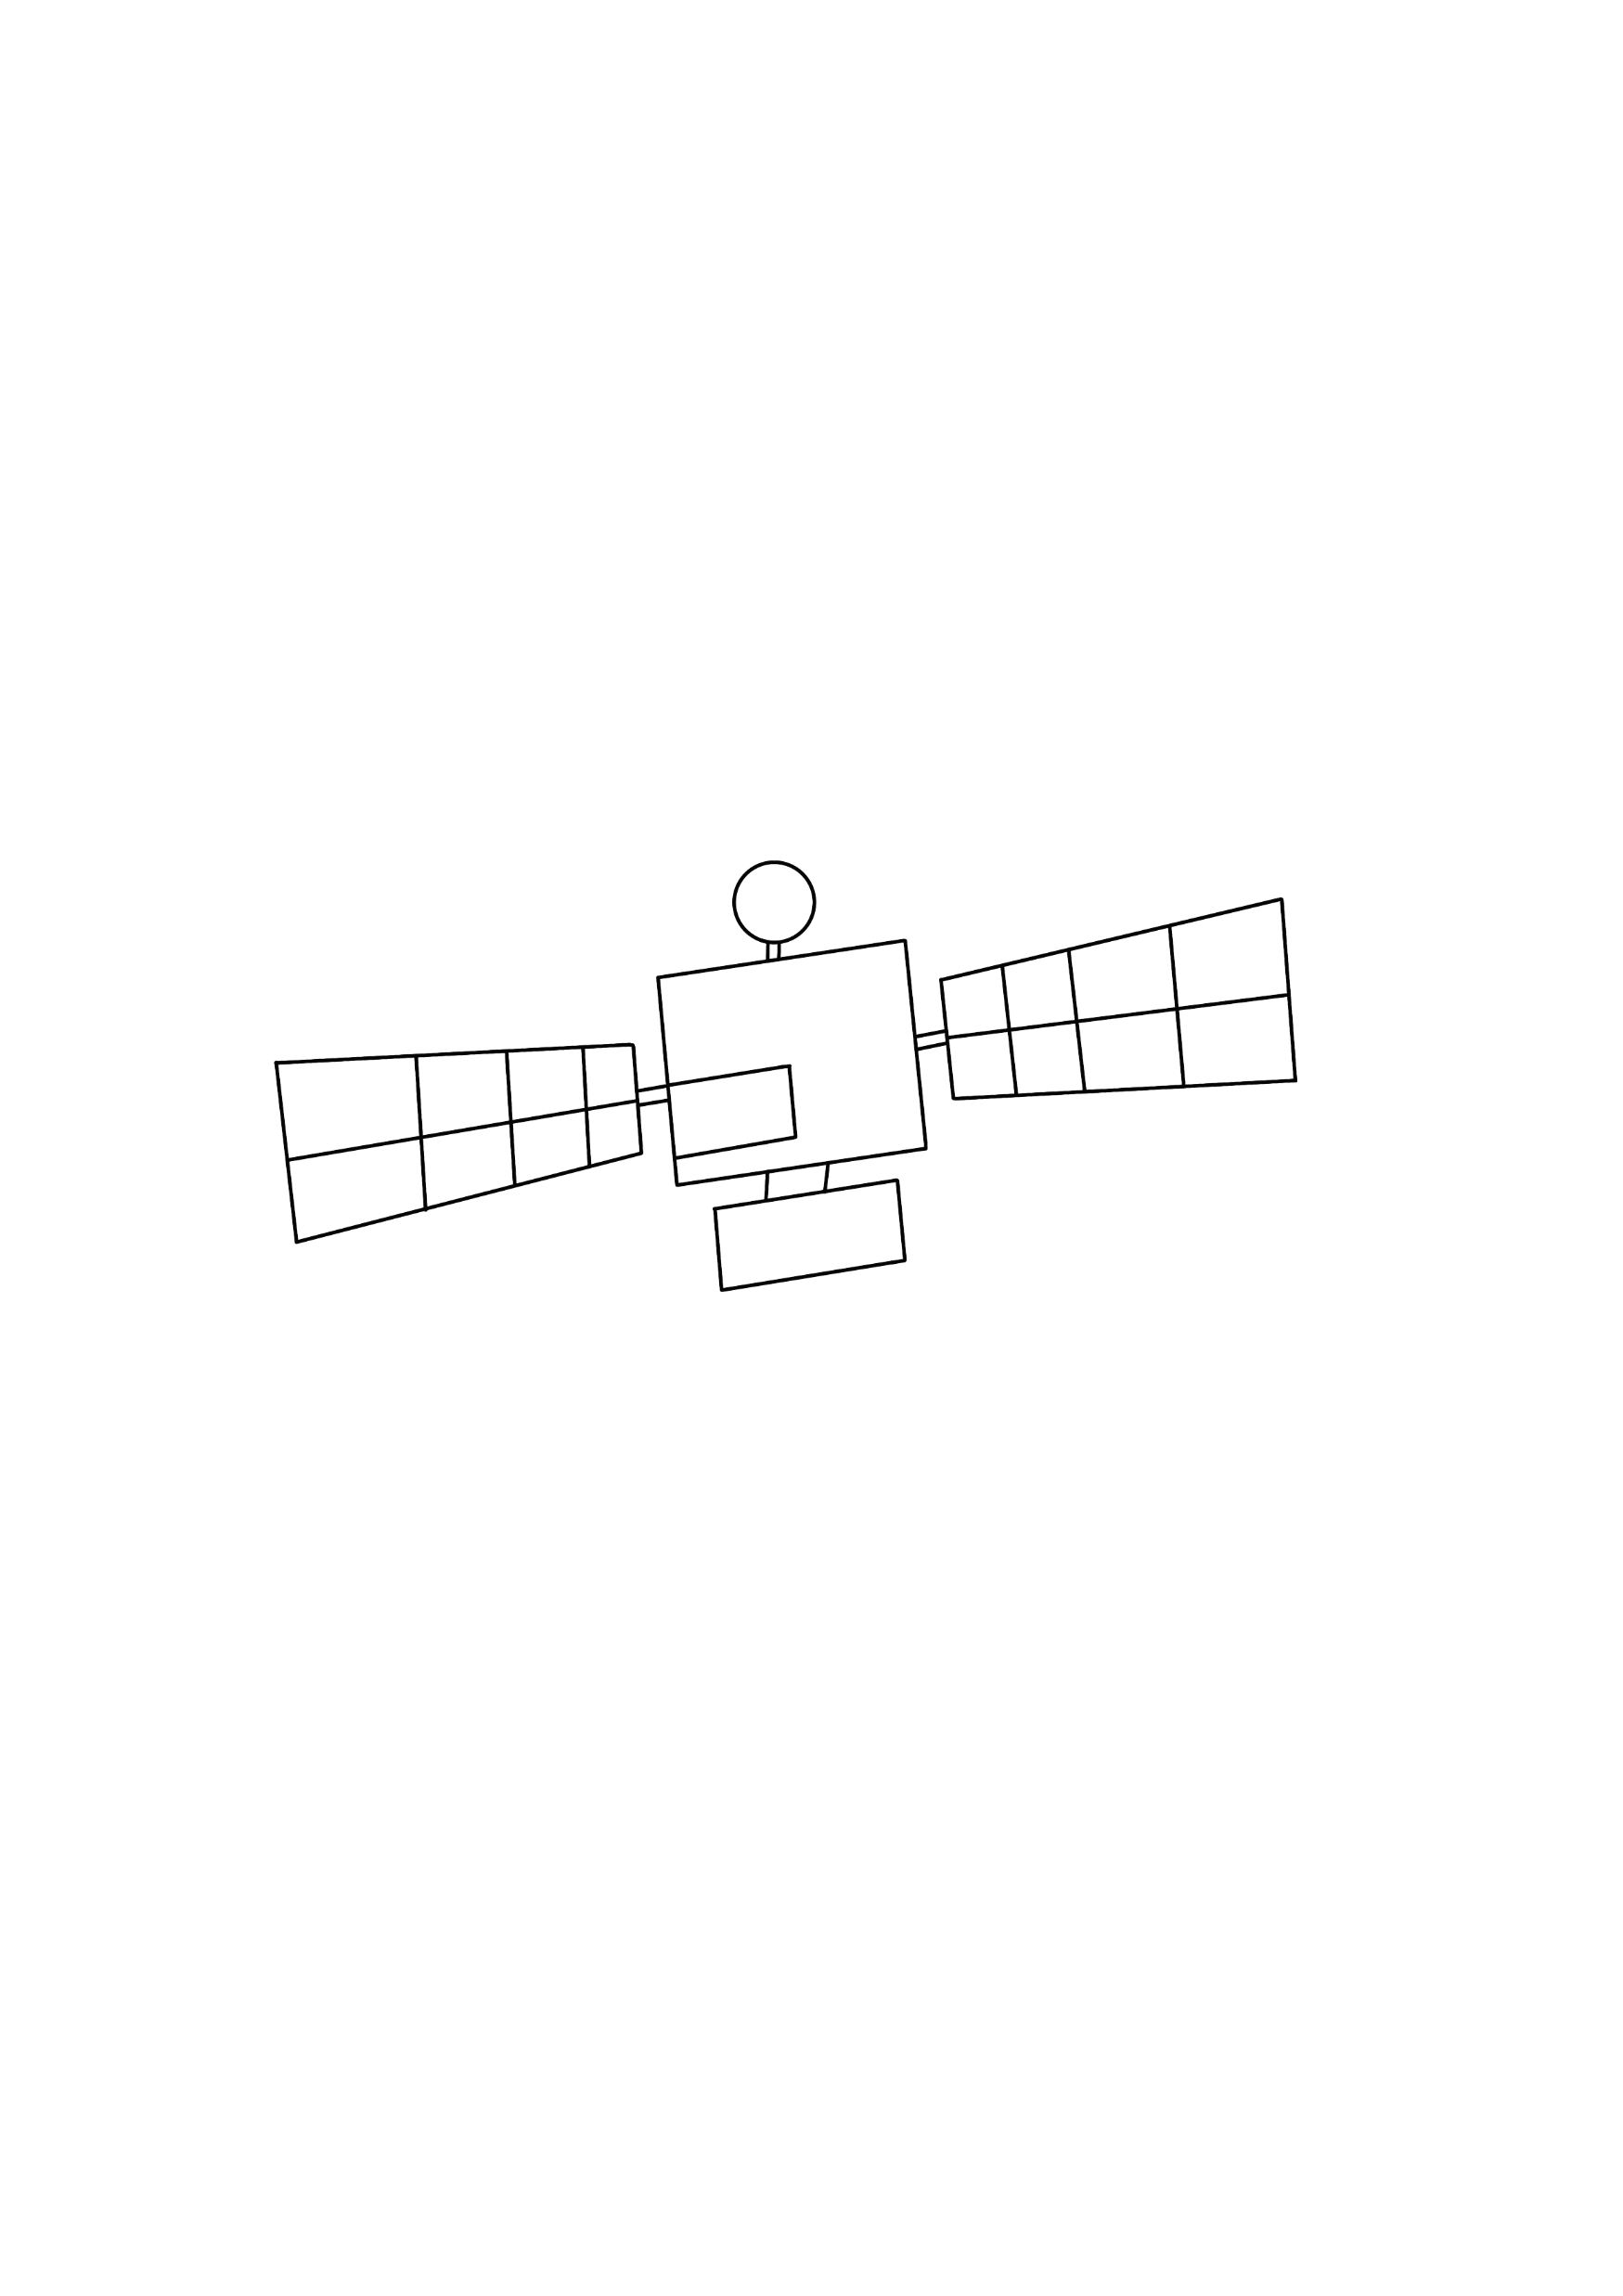
听说
年少的你

Slide 2
···························································································································
不怕
这个世界的
纷繁复杂

Slide 3
执意
飞翔

Slide 4
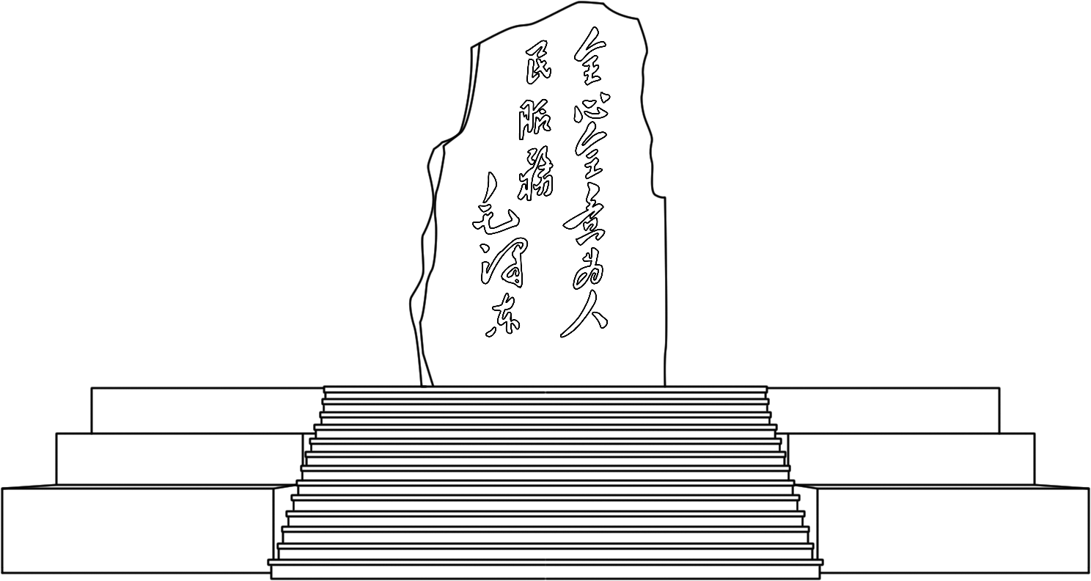
···························································································································
直到长出翅膀
你要一直飞

Slide 5
···························································································································
喜欢星河
是西电借我一束光

Slide 6
闪耀整个黑夜

Slide 7
闪耀整个黑夜

Slide 8
···························································································································
···························································································································
···························································································································
···························································································································
···························································································································
···························································································································
听说
你要在一滴水里，找到浩瀚的海洋

Slide 9

································································
观光塔

Slide 10
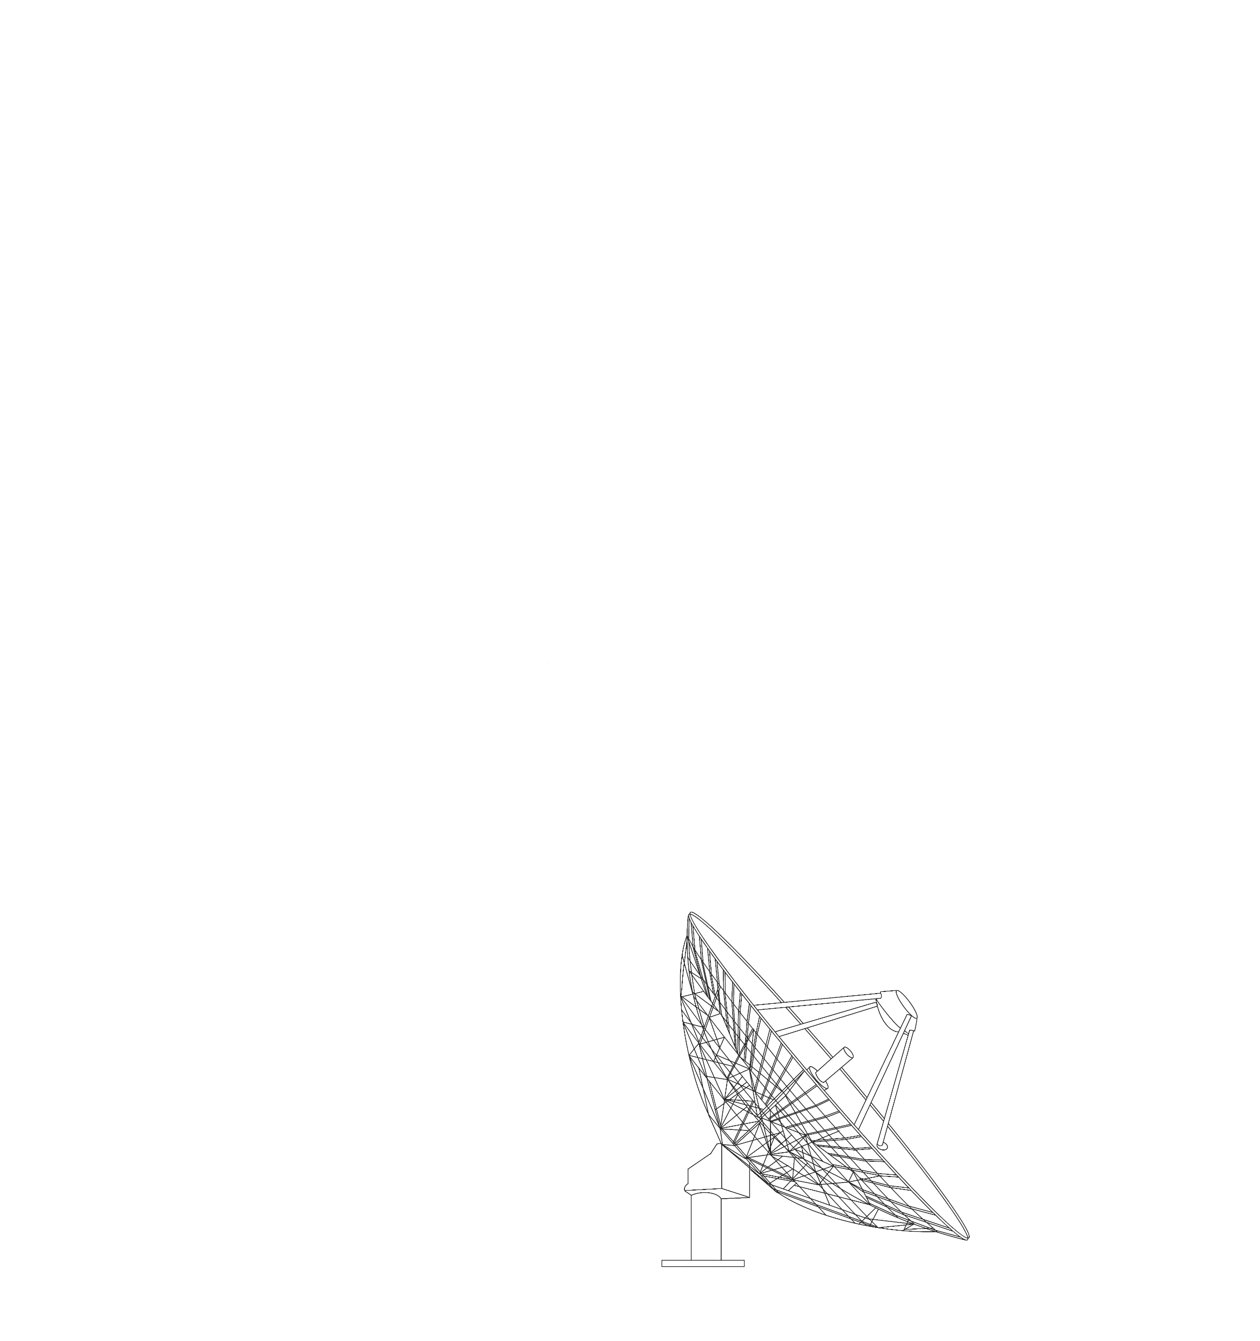

································································
雷达

Slide 11

································································
逐日工程

Slide 12
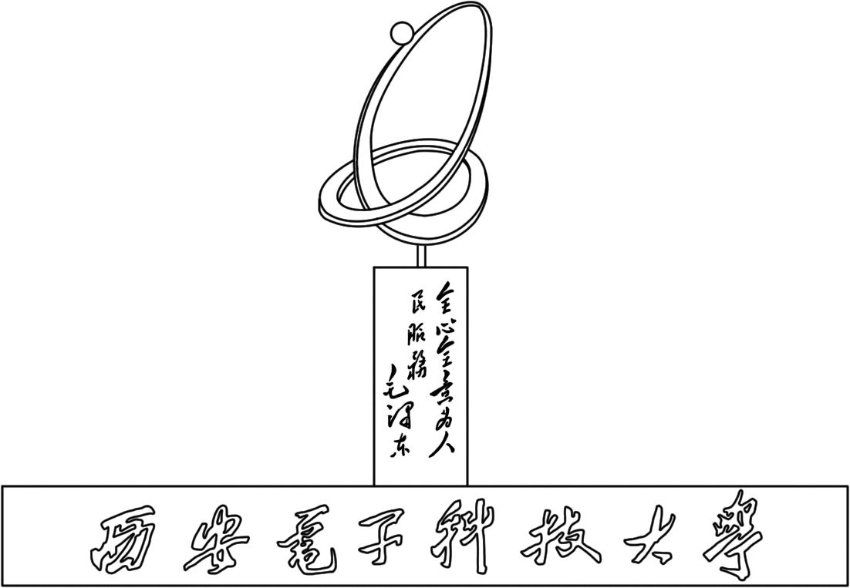
···························································································································
···························································································································
···························································································································
···························································································································
你应该向着海洋的方向流淌
你应当绽放烟火
年少的，丰满的水滴啊
···························································································································
···························································································································

Slide 13
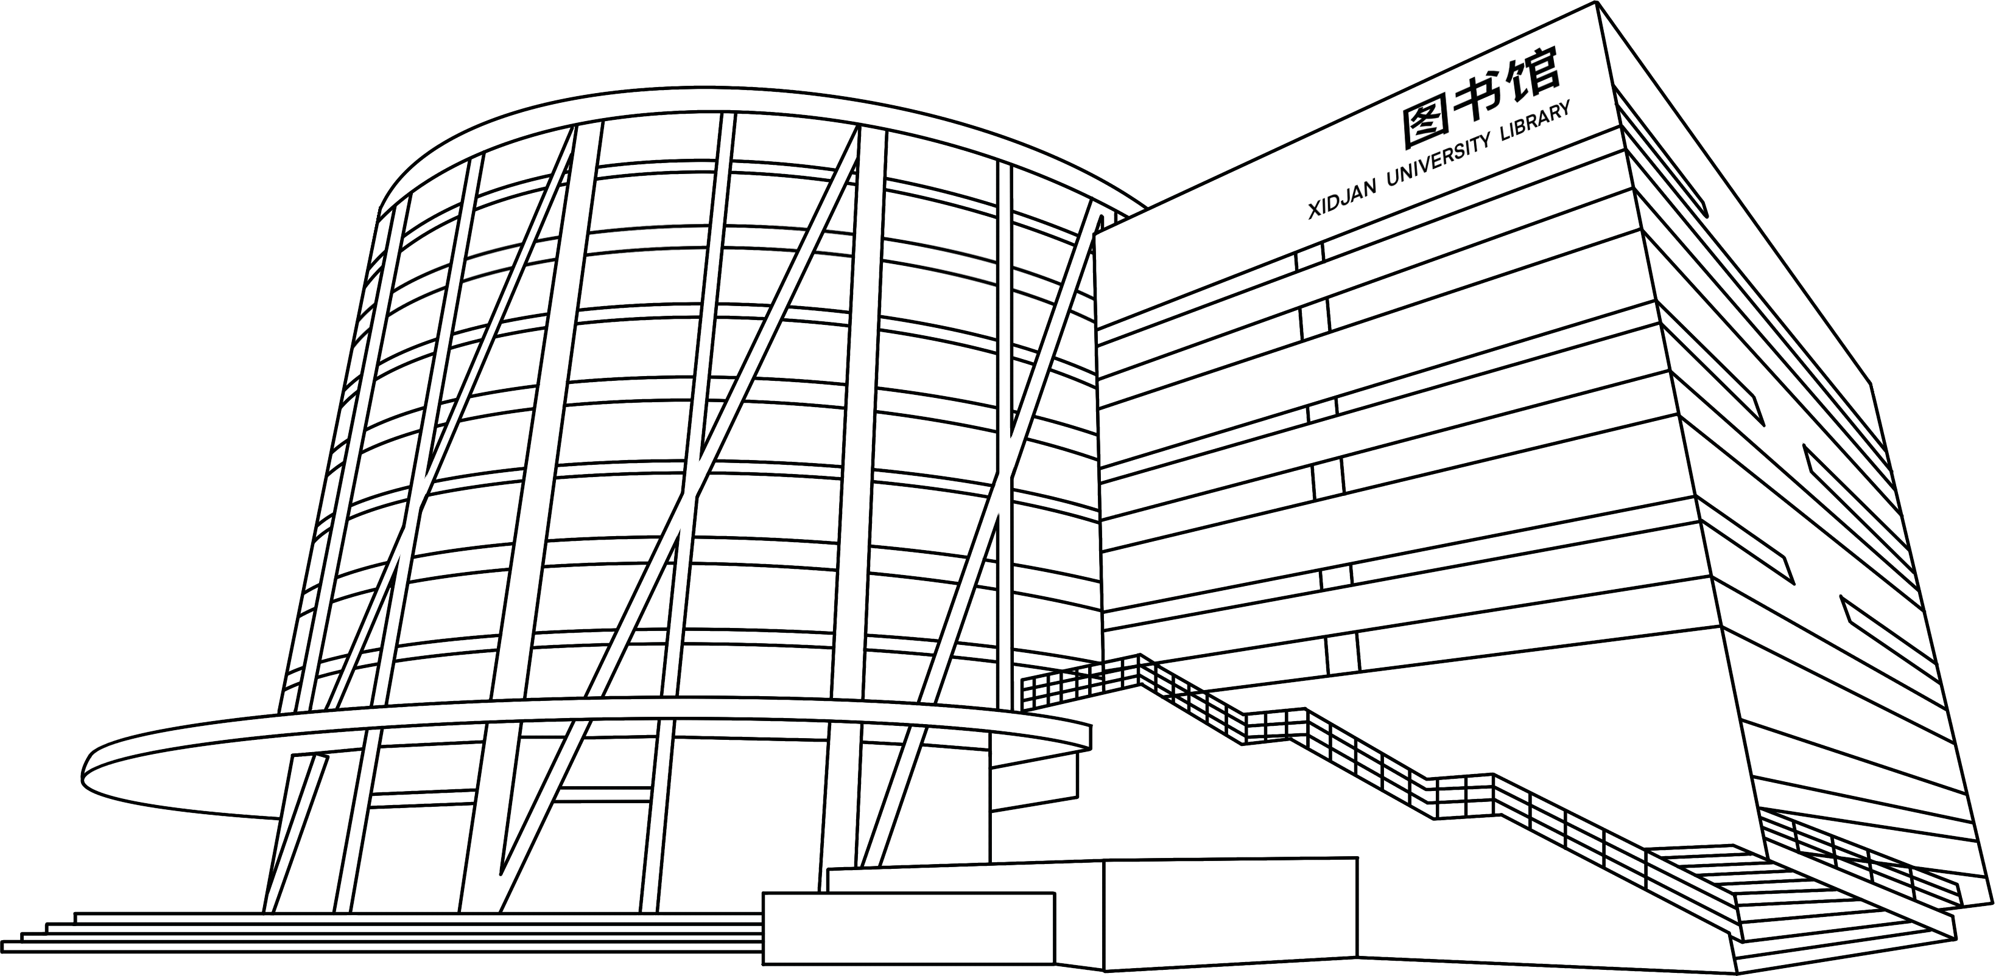
然后奔向远方
跟随满天星辰
静静发光
乘着光努力向上
···························································································································

Slide 14
···························································································································
就好像90多年前那一群人
穿过荆棘，用半部电台起家

Slide 15
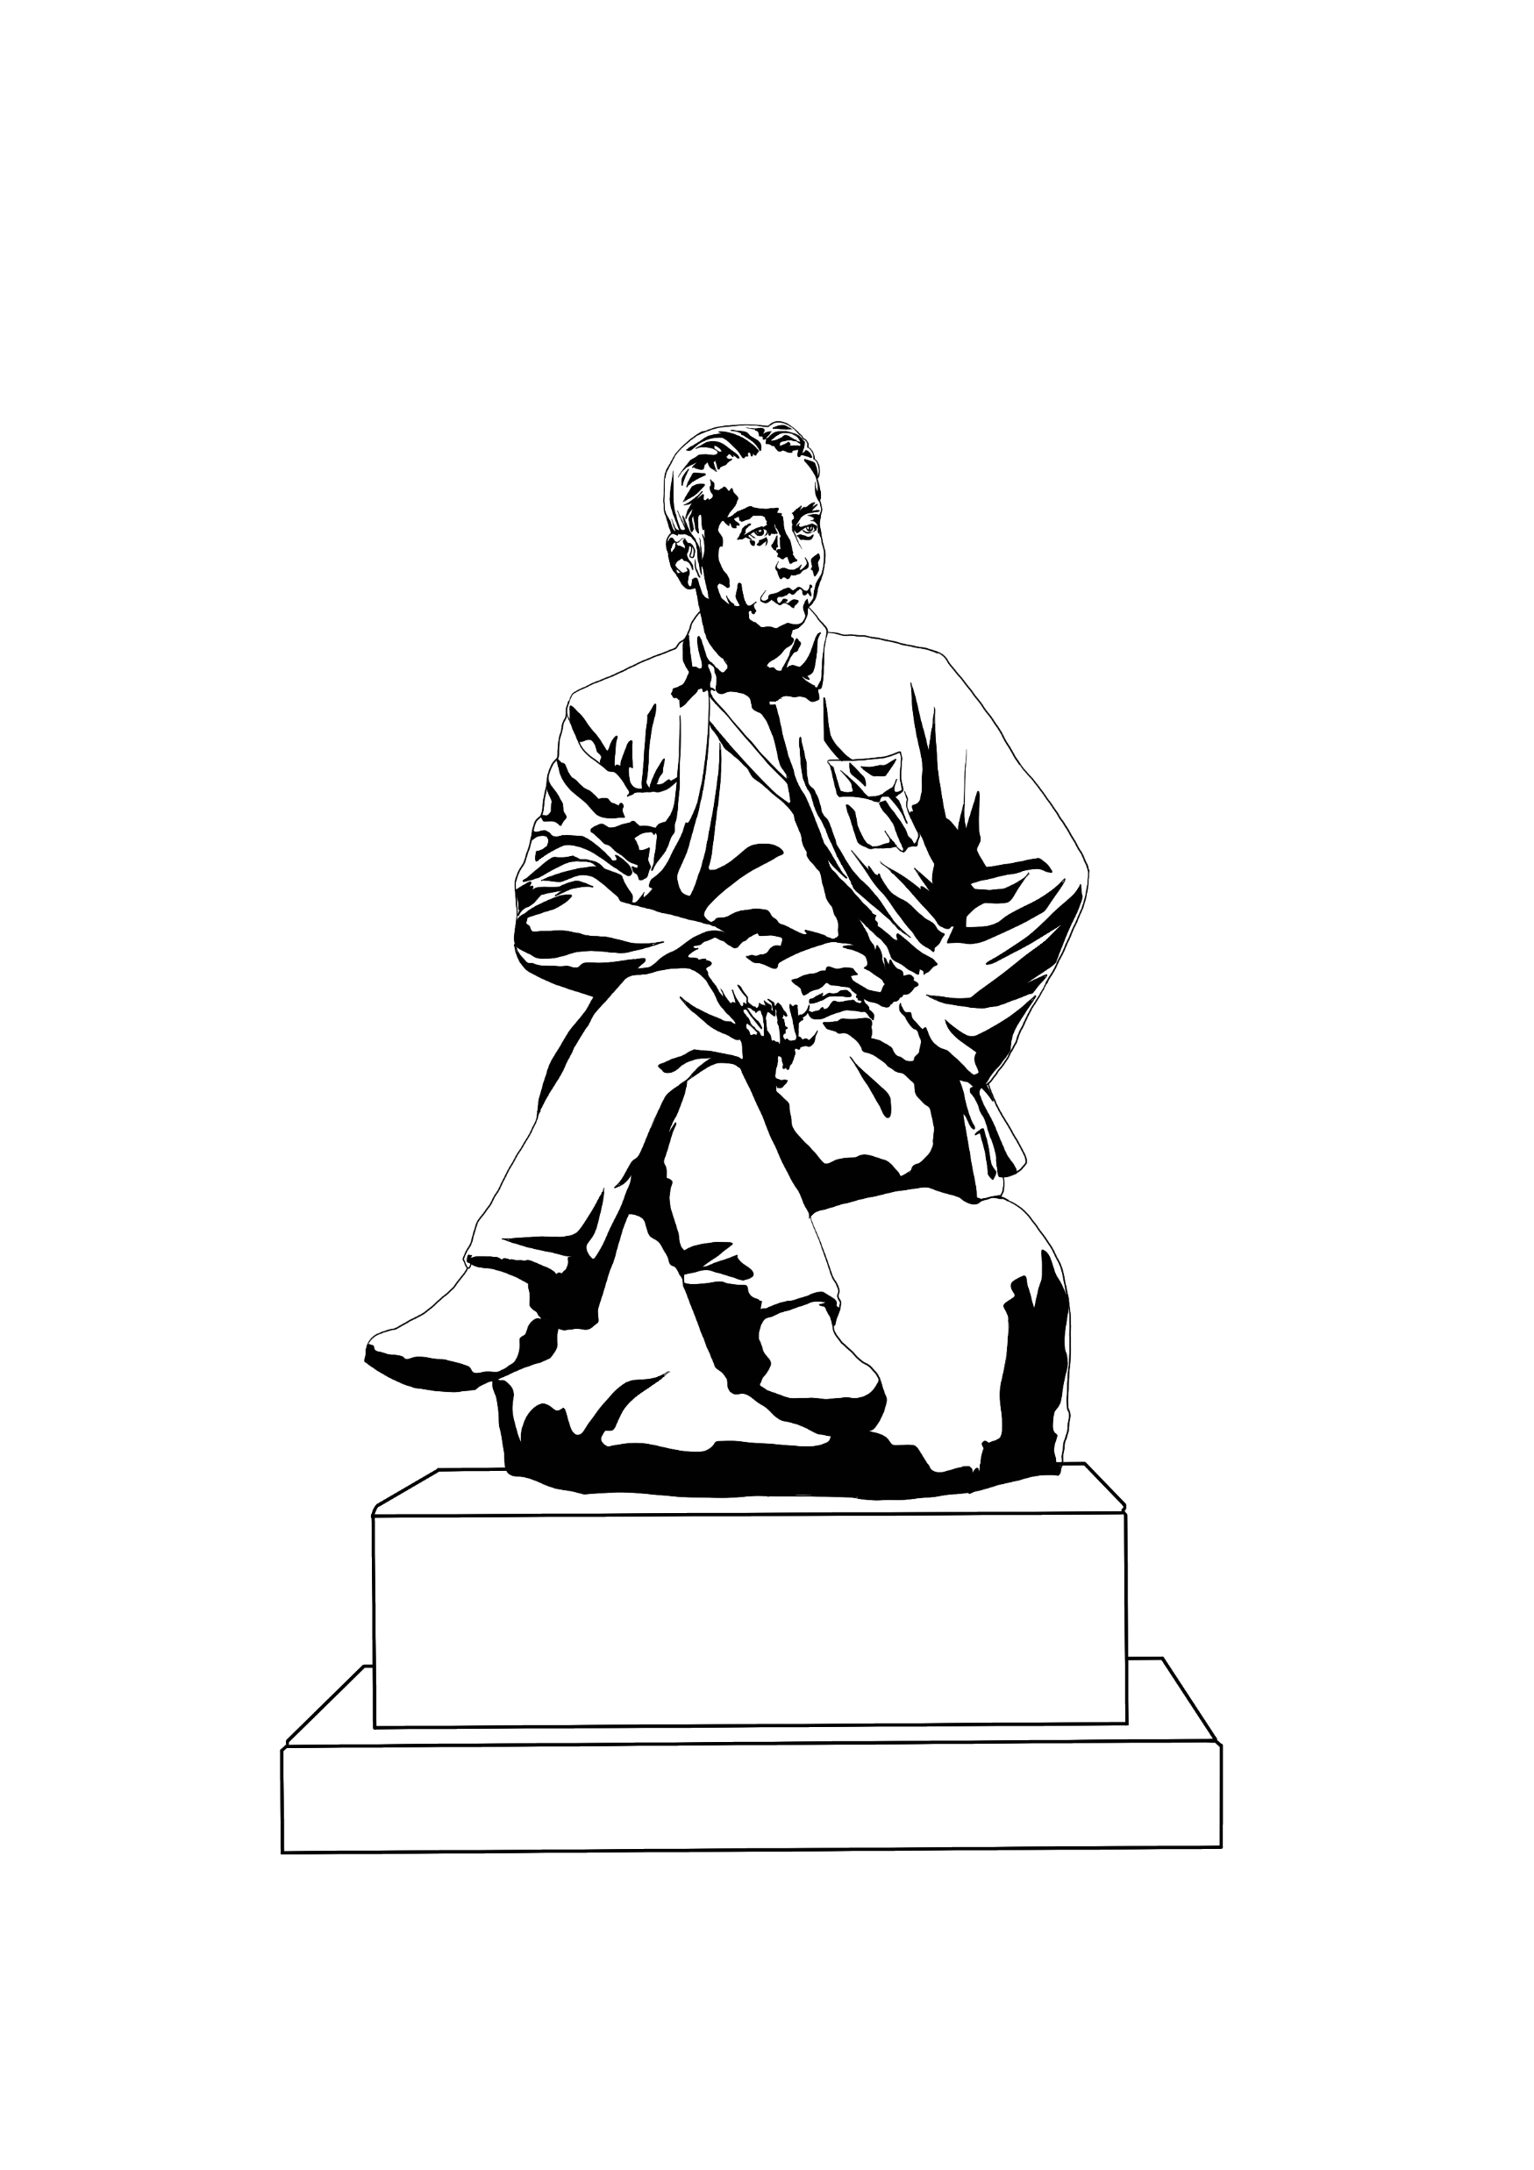
···························································································································
在长征路上办学

Slide 16
···························································································································
艰难挺过终点

Slide 17
进入大海，每一颗水珠都能折射出太阳的光芒
他们说

Slide 18
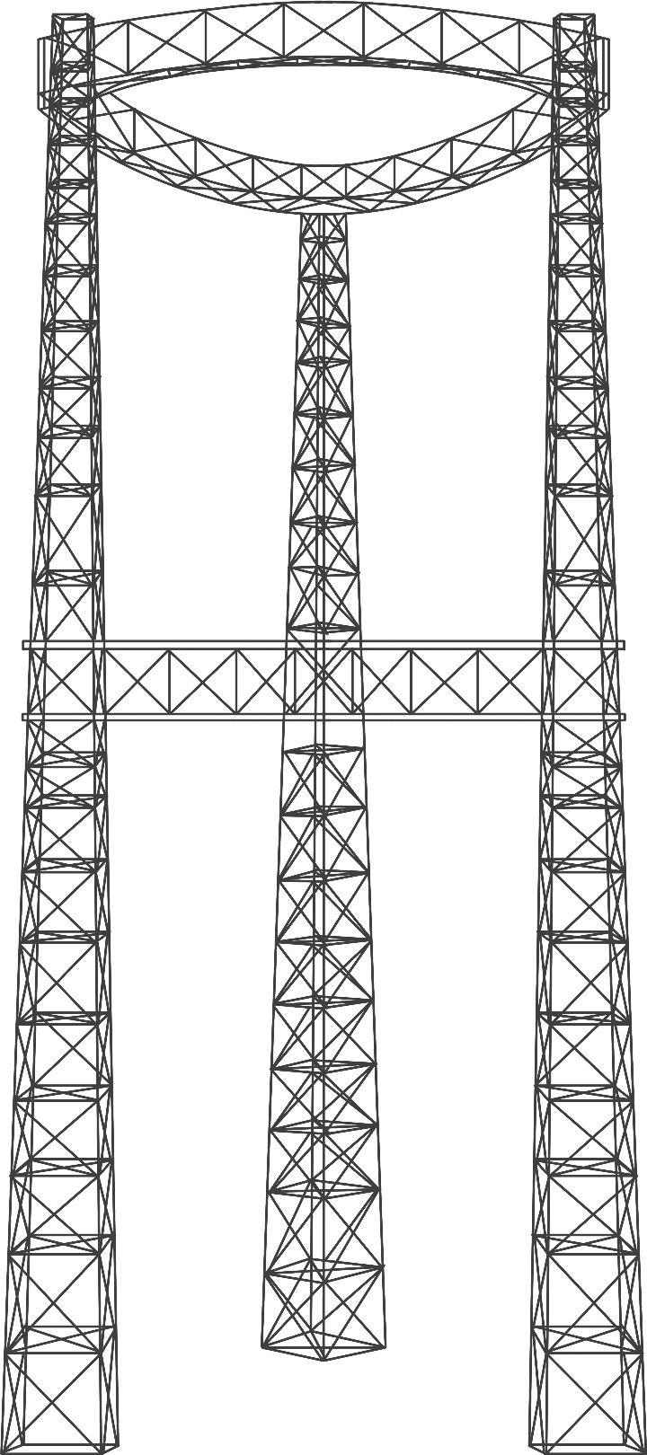
这一滴水，正在将这崇高的精神延续

Slide 19

··························································································································
···························································································································
这一滴水，正在将这崇高的精神延续
亲手为更多的水滴
开拓伟大的航向

Slide 20
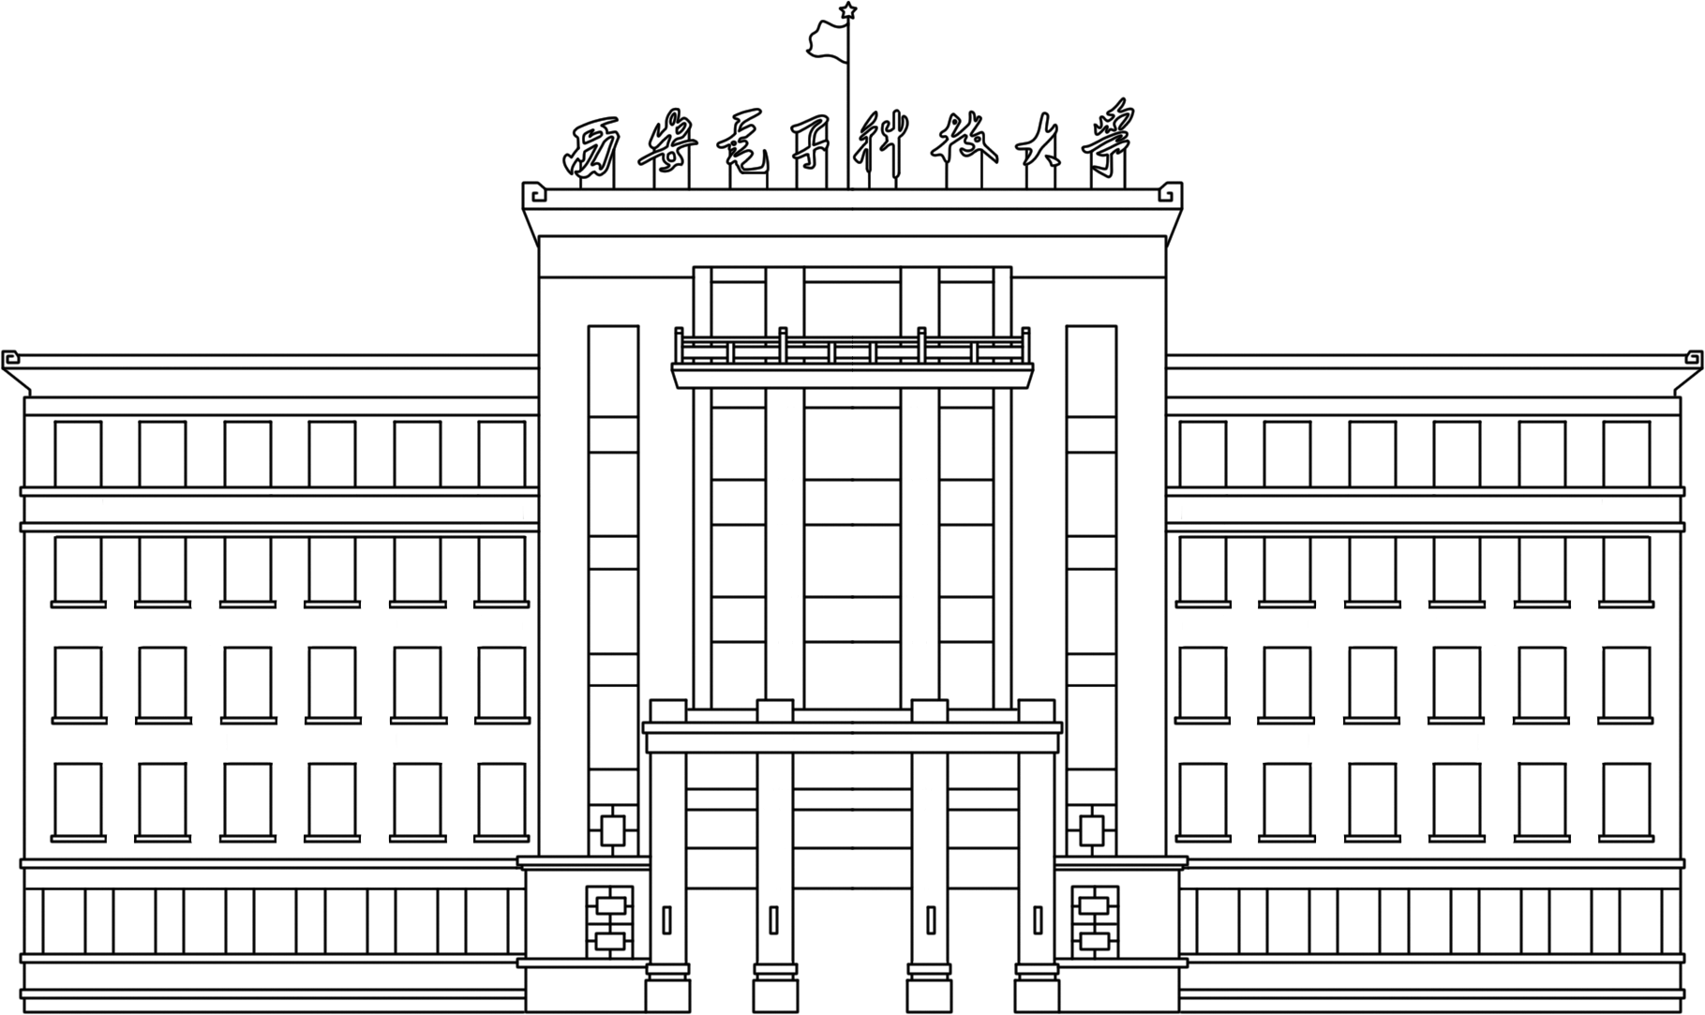
··························································································································
每一颗水滴，都在这里汇聚

Slide 21
···························································································································
汇入星辰大海

Slide 22
开
始
习
惯
凌
晨
五
点
半
的
太
阳
我
一
把
自
多
给
人
样
夜
和
己
献
黑
很

Slide 23
黑
夜
中
醒
等
某
个
日
出
从
也
许
是
来

Slide 24
夜
个
醒
来
也
许
中
个
从
夜
黑
日
献
样
人
点
什
远
给
三
人
永
晨
多
和
自
很
己
不
我
凌
黑
把
在
的
熬
夜
么
习
的
白
着
始
开
惯
阳
太
半
活
明

Slide 25

个
醒
来
也
许
中
个
献
从
夜
黑
日
样
人
点
什
远
给
三
人
永
晨
多
和
自
很
己
不
我
凌
黑
把
在
的
熬
夜
么
习
的
白
着
始
开
惯
阳
太
半
活
明
················································

Slide 26
突
破
自
己

Slide 27
听说
年少的你
将要
汇入大海

